Slide 1
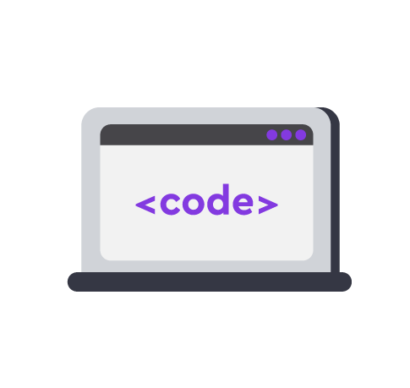

Assigning roles:
Part of the talk | Who tells it
Introduction, project goal | Richard
What does the created software include? (mention the publishing of developments on GitHub and the license!) | Korbyn
Features of the developed project (how does it stand out from others?) | Neel
Demonstration of the project (interface and functionality overview)
Prospects for the project (how can it be improved and expanded?) | Satya
Conclusion, answering questions | Vlad
Project
presentation

Slide 2
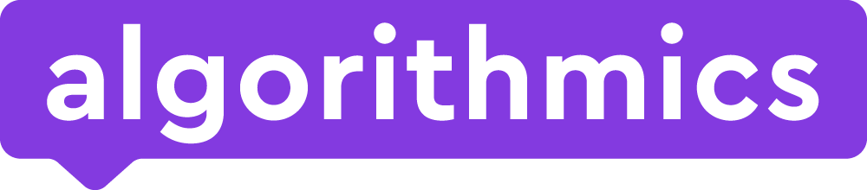
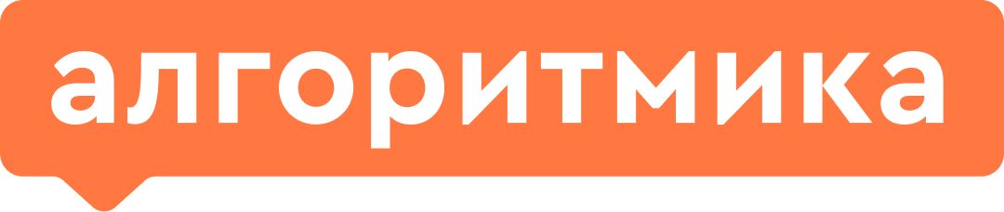
Template.
Project
presentation

Slide 3
The goal of the project is...
(What outcome would the customer like to see?)
(What did you need to program and why?)
This project will be an simple but exciting retro Ping-Pong game. This is an multiplayer game which you can play with your friends and family. We made this project so that the investors will see the potential of the game to further help us develop it more.
Project
presentation

Slide 4
The developed project includes the following components:
(Program file)
(Images)
(README file)...
The developed prototype is assembled in the repository...
Project
presentation

Slide 5
Distinctive features of the project
This project is unique compared to others because it is a quick way to have fun and satisfy your entertainment needs. It is a two-player game with a ball, and two rackets. Both players keep on hitting the ball back and forth until one person misses it (the loser).
Project
presentation

Slide 6
Distinctive features of the project
(The prototype was created in a short time thanks to the use of previously developed...)
Project
presentation

Slide 7
Distinctive features of the project
(There is a line that appears in the game that notifies you when it’s over...)
Project
presentation

Slide 8

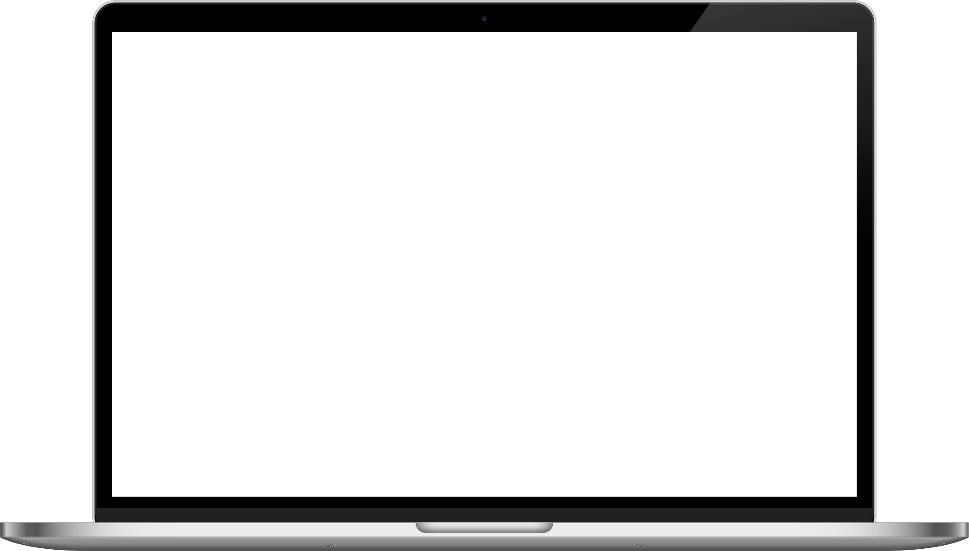
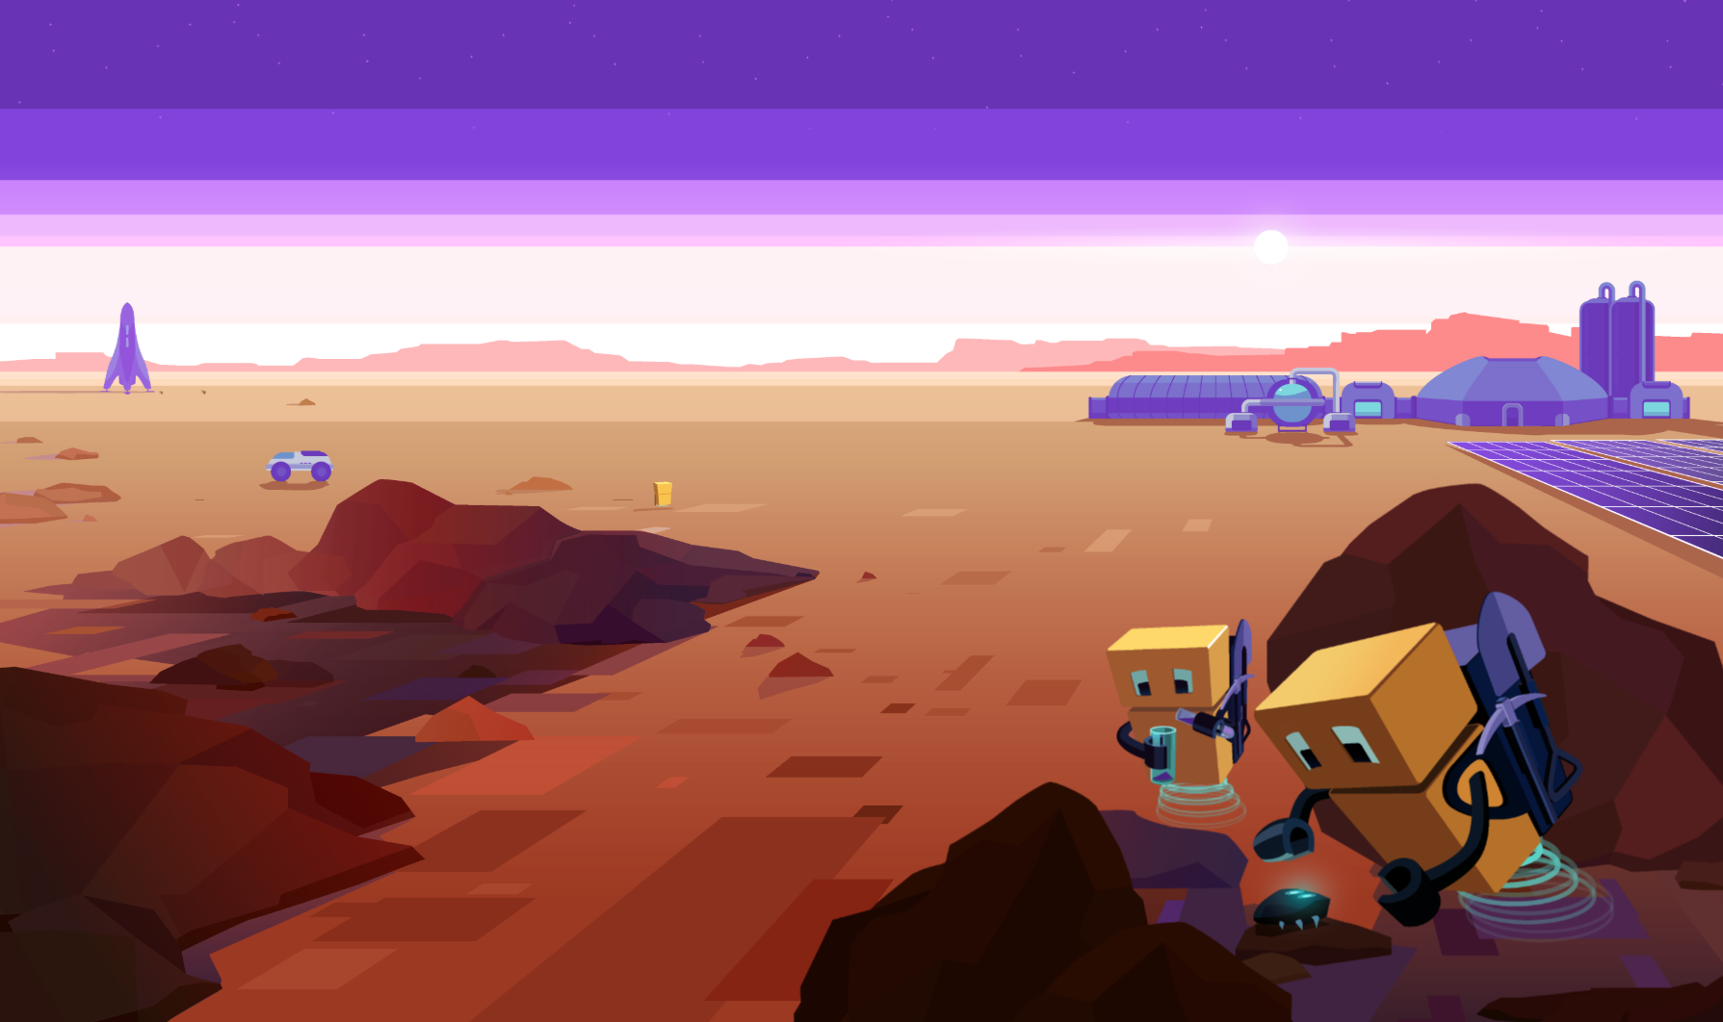

Demonstration of the project
Ping-Pong
Start the demo!
Project
presentation

Slide 9
Prospects of the project
(Would it be possible to program a full-fledged Ping-Pong game rather than a prototype? What modifications could improve the game?)
This project could be edited to create an incredibly good game. We could edit it by adding a proper background, using better made player and game sprites, and adding more features such as a scoreboard, skins for the pingpong table and the rackets and other minor details. Although we made the game as multiplayer, it could be made as single player by adding AI to the game. This could bring in a variety of things you could add with this. Levels, bosses etc. We believe that our game can be greatly improved and its prospects are quite bright.
Project
presentation

Slide 10
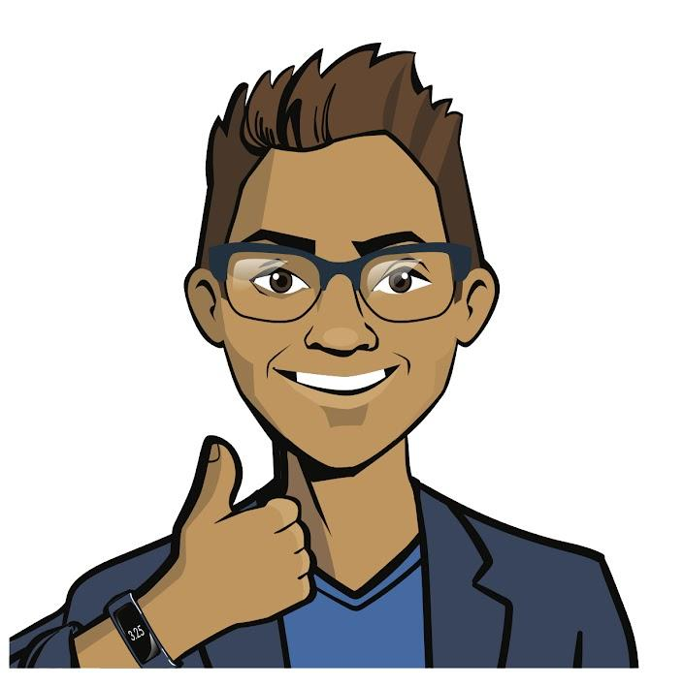
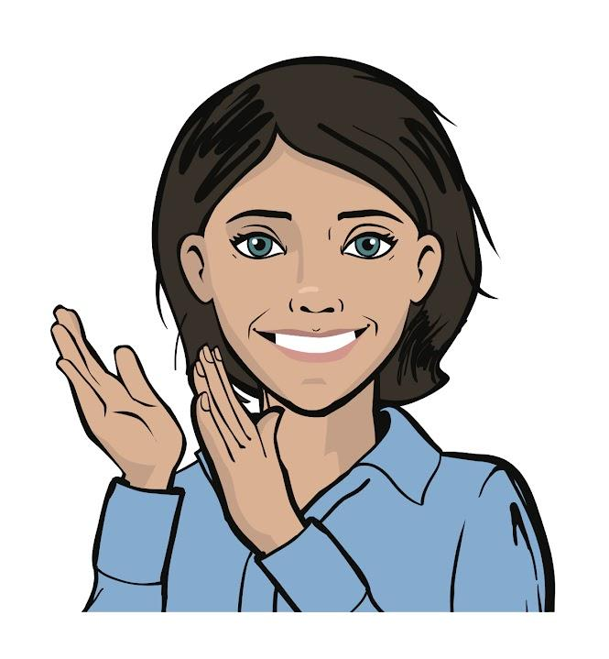
Thank you for listening
We will be happy to answer your questions and get feedback.
Project
presentation

